Slide 1


Library Catalog System
Course Code: CSA1122
Course: Object Oriented Analysis and Design for System Simulation
Guided by –
Dr. S. Saranniya (Assistant Professor) SIMATS Engineering
DR. MS. Sarvannan(Professor)
SIMATS Engineering
Presented by –
C Venkata Sainath Reddy(192373040)
N Vishnu Vardhan Reddy(192372175)

Slide 2
INTRODUCTION
Libraries are essential parts of academic and professional institutions, providing access to books, journals, and digital materials.
Traditional library systems often struggle with manual record-keeping, slow book tracking, and handling large amounts of data.
The Library Catalog System aims to make managing the system helps students and researchers efficiently find and manage resources.
This modern approach improves accuracy, saves time, and enhances user experience within the library.

Slide 3

PROBLEM STATEMENT
Students and researchers face difficulty finding relevant books quickly in large libraries due to lack of organized catalog systems.
Manual tracking of books, authors, and genres leads to inefficiency and errors in library management.
Applying OOP principles can create a scalable, modular system for managing and searching books efficiently for both students and researchers.

Slide 4
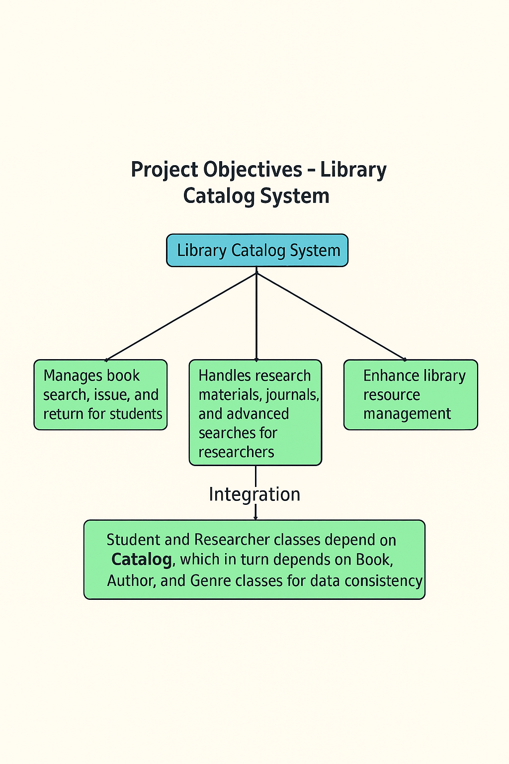
PROJECT OBJECTIVES
1-Manages book search, issue, and return for students.
2-Handles research materials, journals, and advanced searches for researchers.
Integration: Both modules interact with the Catalog, Book, Author, and Genre classes to access and manage book information.
Dependency: Student and Researcher classes depend on Catalog, which in turn depends on Book, Author, and Genre classes for data consistency.

Slide 5
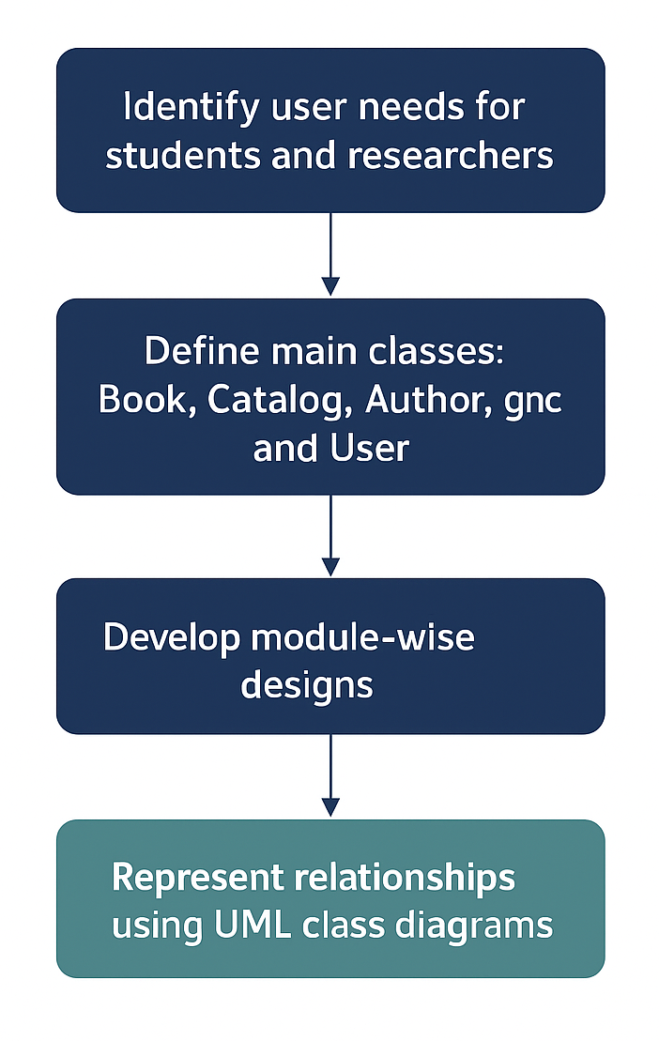
METHODOLOGY
Identify user needs for students and researchers, and define main classes like Book, Catalog, Author, Genre, and User.
Apply encapsulation to protect data, inheritance for user roles (Student and Researcher).
Develop module-wise designs—Module 1 for students, Module 2 for researchers —and represent relationships using UML class diagrams. Tools and Technologies:
Umbrello 2.32.0

Slide 6
IMPORTANCE OF THE PROBLEM
Efficient book management and search are essential for students and researchers to save time and access accurate resources.
Traditional catalog systems lack automation and flexibility, making it difficult to handle large and diverse collections.
Applying OOP principles provides a scalable, maintainable, and reusable structure that enhances library system performance and user experience.
The system supports academic growth by simplifying access to educational and research materials through organized data handling.

Slide 7
Manage book search, issue, and return for students.
MODULE - 1
Objective & Core Concepts
Goal:Enable students to efficiently search, borrow, and return books while keeping track of availability and usage.
Key Concepts Used:
Encapsulation: Securely store and manage book and student data.
Polymorphism: Search and catalog functions behave differently for students.
Module Integration: Updates book status in real time with the main catalog.
Dependency Management: Relies on catalog data for book availability and validation.

Slide 8
Solutions & Recommendations:
Implemented a secure book catalog using Encapsulation to protect student and book data.
Applied Polymorphism in the search function to allow flexible search options (by title, author, or genre).
Improved the borrowing and return workflow through automated catalog updates and fine calculation.
Recommended adding a notification feature to remind students about due dates and overdue fines.
Suggested future enhancement: integrate with an online book reservation and e-book access system.

Slide 9
Result
The system successfully allows students to search, borrow, and return books efficiently.
Demonstrated correct application of Encapsulation and Polymorphism in class design.
Achieved accurate book tracking and reduced manual effort in record-keeping.
System performance is smooth, with real-time catalog updates and secure data handling.

Slide 10
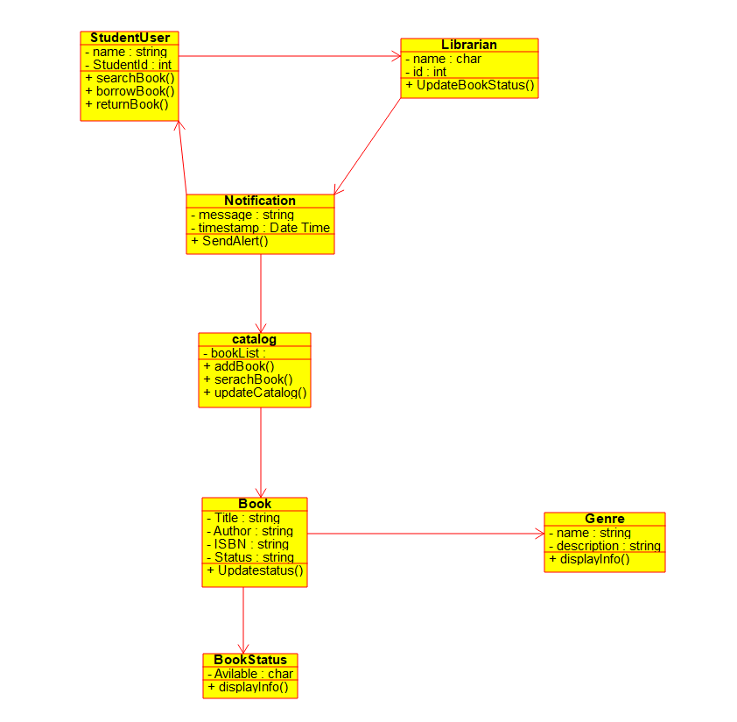
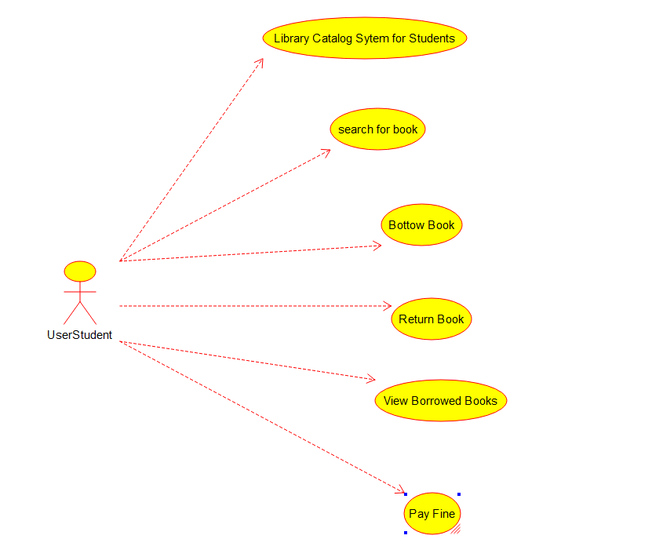
OUTPUT
Class Diagram
Use Case Diagram

Slide 11
Module - 2
Handles research materials, journals, and advanced searches for researchers.
Goal: Enable researchers to efficiently search, access, and manage research papers, journals, and publications with advanced filtering and categorization.
Key Concepts Used:
Encapsulation: Secures detailed research materials and author information.
Inheritance: ResearcherUser class inherits common features from User class.

Slide 12
Solutions & Recommendations:
Designed an advanced research catalog using Inheritance for reusability and Encapsulation for data protection.
Improved search efficiency by adding filtering options (author, domain, publication year).
Integrated a structured data model connecting ResearcherUser, Catalog, Book, and Author.
Suggested future scope: enable collaboration tools for researchers to share or cite resources.

Slide 13
Result
The system efficiently supports advanced search and access to research materials.
Demonstrated successful use of Inheritance for modular design and code reusability.
Enhanced researcher productivity by enabling organized and quick access to academic resources.
Achieved smooth interaction between classes, ensuring secure and scalable system performance.

Slide 14
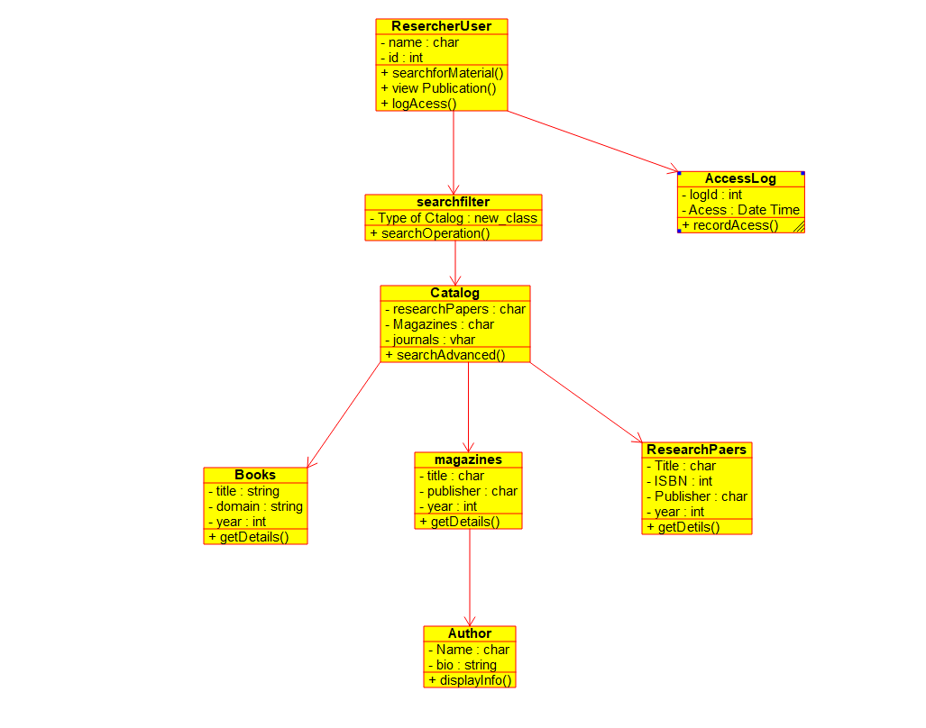
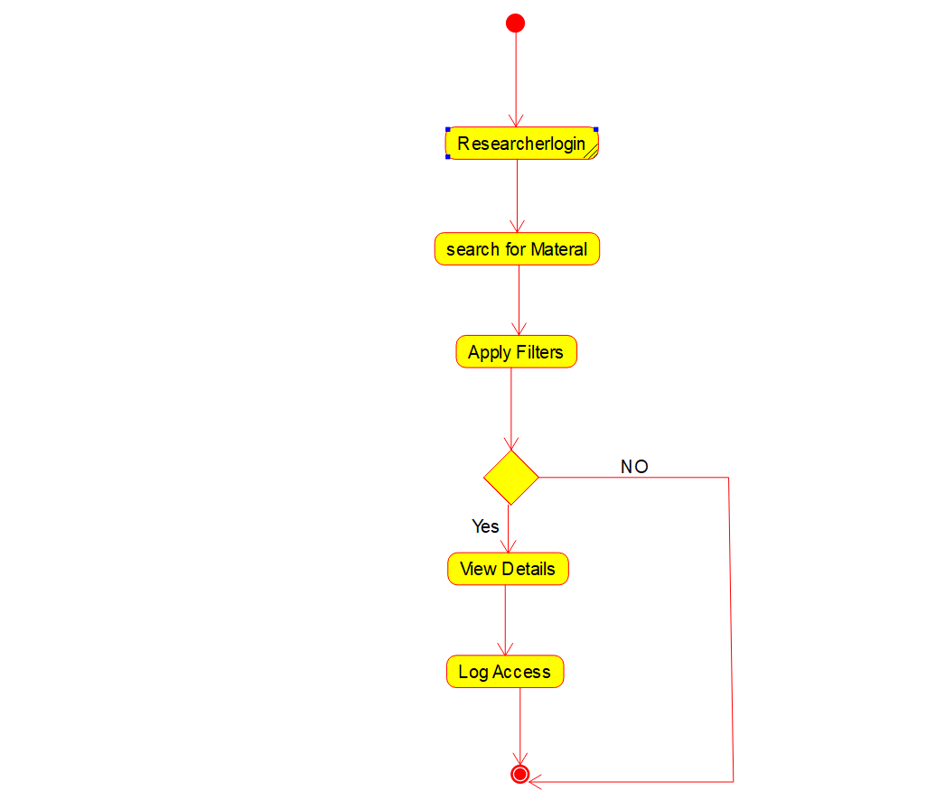
OUTPUT
Class Diagram
Activity Diagram

Slide 15
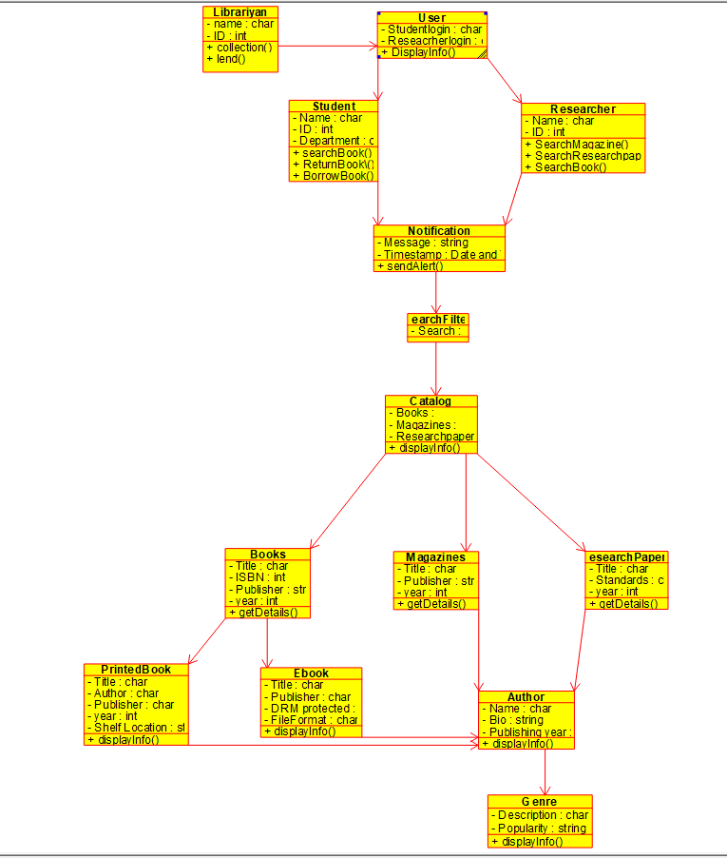
Overall Output

Slide 16
CONCLUSION
The Library Catalog System was successfully designed using Encapsulation, Inheritance, and Polymorphism — to create an efficient and scalable platform for managing and searching books.
The system was divided into two specialized modules:
Module 1 – Library Catalog System for Students: Focused on providing students with easy access to textbooks and academic resources through secure data handling (encapsulation) and flexible search features (polymorphism).
Module 2 – Library Catalog System for Researchers: Designed to support advanced search, categorization, and research material management using encapsulation and inheritance for data reusability and efficient record handling.
Together, these modules ensure a smooth and intelligent library experience for both students and researchers, improving resource accessibility, operational efficiency, and user satisfaction

Slide 17
REFERENCES
Salaba, A., & Chan, L. M. (2023). Cataloging and classification: an introduction. Rowman & Littlefield.
Khan, H., DeMarco, C., Fernsebner Eslao, C., Folsom, S., Kovari, J., Warner, S., ... & Usong, A. (2022). Using linked data sources to enhance catalog discovery. KULA, 6(3), 1-26.
Hussain, A. (2023). Use of artificial intelligence in the library services: prospects and challenges. Library Hi Tech News, 40(2), 15-17.
Dong, E. (2021). Automating Cataloging Workflow of Library Traditional Materials. International Journal of Librarianship, 6(1), 73-88.
Dong, E. (2021). Automating Cataloging Workflow of Library Traditional Materials. International Journal of Librarianship, 6(1), 73-88.

